Slide 1


Technical Report
Writing
Dr/ Youssef Gamal

Slide 2

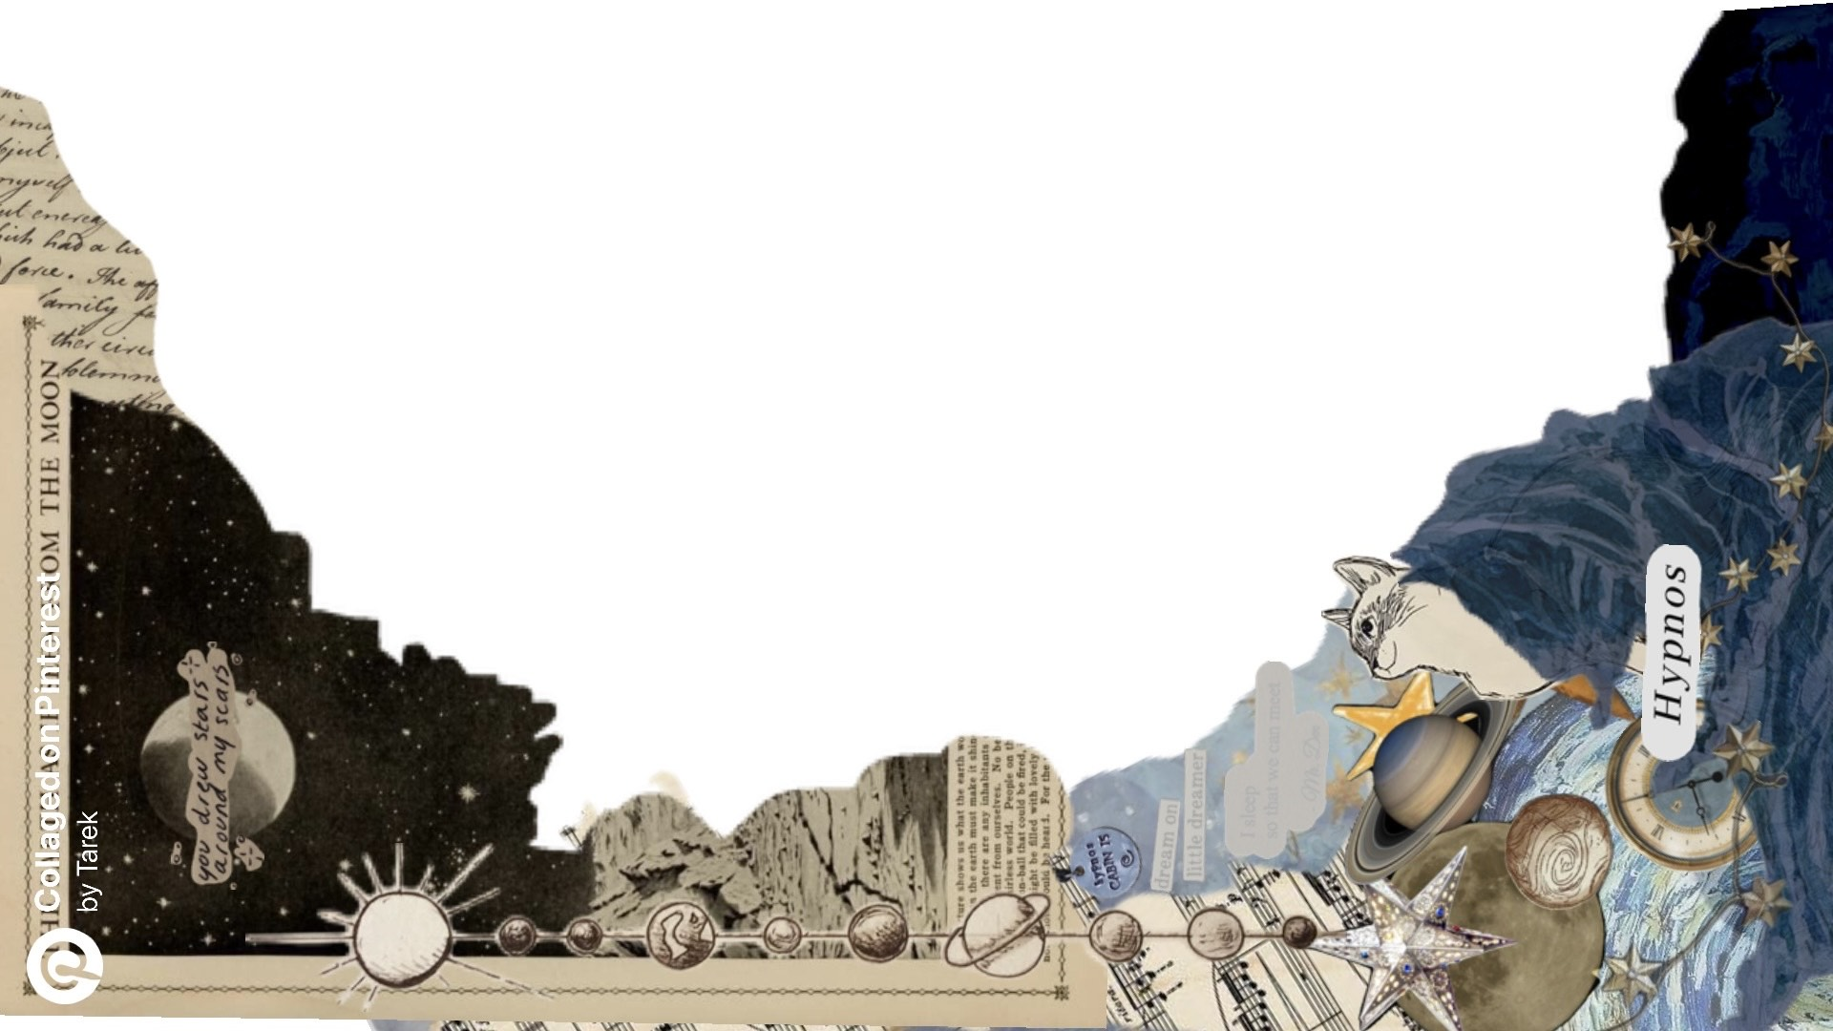
Space Garden
Game
Dr/ Shady

Slide 3
Space Garden
Game
Dr/ Shady

Slide 4


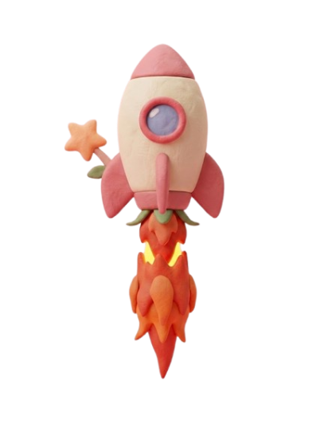

OUR
TEAM
Isen Mohammed
Malak Marwan
Youssef Atef
Logien Abdelrahman
Tasabeeh Mohammed
TEAM 13

Slide 5


PROJECT IDEA

Slide 6

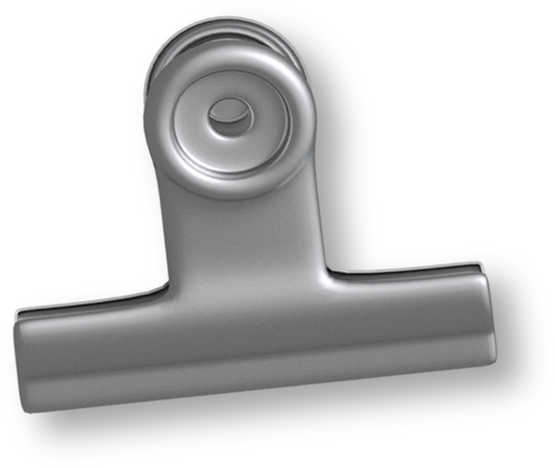
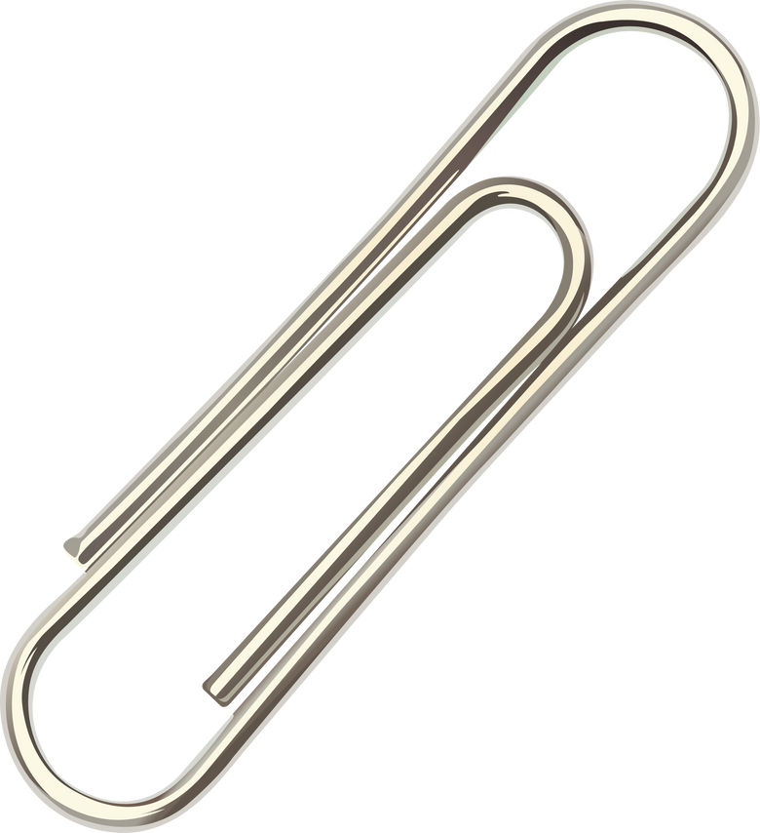



PROJECT IDEA
What is Space Garden Game?
Our project is an interactive educational toy designed to combine learning and entertainment for children. The toy encourages kids to solve mathematical questions while interacting with different mechanical systems.
The child is presented with a math question on a display screen. If the answer is correct, a ball is released and moves through the toy's internal pathway. If the answer is incorrect, the ball remains locked, motivating the child to try again and improve their mathematical skills.
This approach helps children practice problem-solving, critical thinking, and hand-eye coordination in an engaging way.
1
Medical and Scientific Papers:
Technical writing in the medical and scientific field simplifies complex information into clear content that helps researchers interpret findings, organize data, and publish results.

Slide 7



PROJECT IDEA
What is Space Garden Game?
System Operation
Definition
Our project is an interactive educational toy designed to combine learning and entertainment for children. The toy encourages kids to solve mathematical questions while interacting with different mechanical systems.
The child is presented with a math question on a display screen. If the answer is correct, a ball is released and moves through the toy's internal pathway. If the answer is incorrect, the ball remains locked, motivating the child to try again and improve their mathematical skills.
This approach helps children practice problem-solving, critical thinking, and hand-eye coordination in an engaging way.
1

Slide 8
1
System
Operation
A math question appears on the display.
The child enters an answer.
The Arduino checks the answer.
If the answer is correct:
The ball is released.
The ball passes through three different mechanisms.
5. If the answer is incorrect:
The ball is not released.
A new attempt is required.

Slide 9
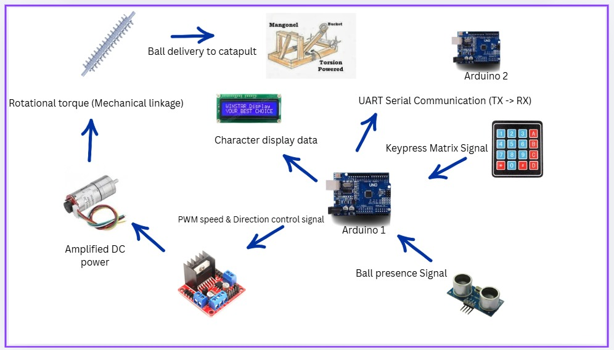
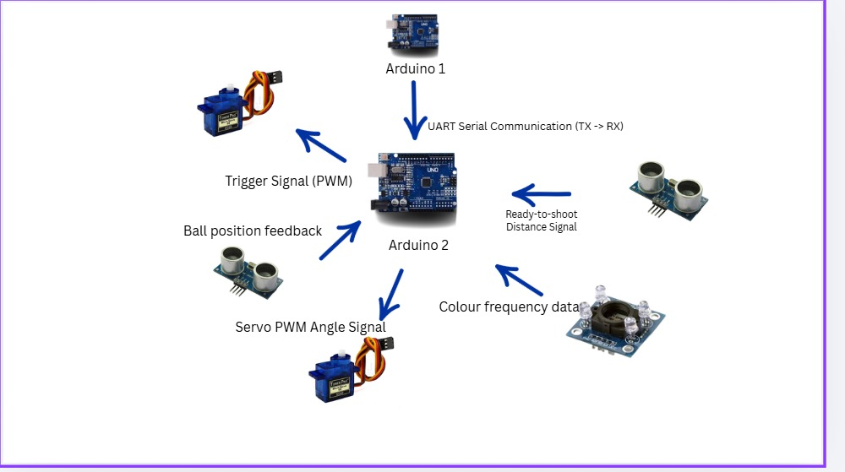
PROJECT IDEA
System Architecture Overview
1
Medical and Scientific Papers:
Technical writing in the medical and scientific field simplifies complex information into clear content that helps researchers interpret findings, organize data, and publish results.

Slide 10
PROJECT IDEA
Control Node 1: User Interface & Lifting
Inputs
Keypad: captures user mathematical answers
Ultrasonic sensor: Detects ball presence at the storage tank entrance
Outputs
LCD: Displays dynamic math questions and system status
H-bridge driver: Regulates power to the lifting motor
1
Medical and Scientific Papers:
Technical writing in the medical and scientific field simplifies complex information into clear content that helps researchers interpret findings, organize data, and publish results.

Slide 11
PROJECT IDEA
Control Node 2: Ballistics & Sorting
Inputs
UART RX Line: Receives success commands from Arduino 1.
Ultrasonic sensor: Detects ball presence at the storage tank entrance
TCS3200 Color Sensor: Identifies ball color using light-to-frequency conversion
Outputs
Shooting Servo Motor: Triggers the catapult mechanism
Sorting Servo Motor: Controls directional gates for color routing
1
Medical and Scientific Papers:
Technical writing in the medical and scientific field simplifies complex information into clear content that helps researchers interpret findings, organize data, and publish results.

Slide 12

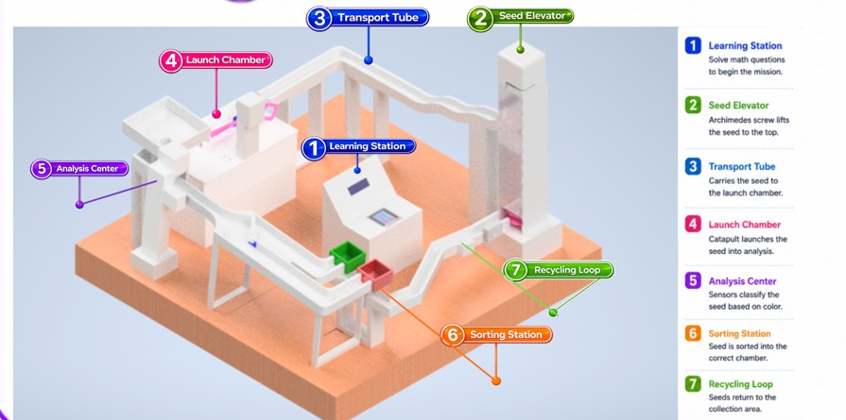
The lifting mechanism uses an Archimedes Screw to transport the ball vertically to a higher level within the toy.
Purpose:
Demonstrate a classical mechanical lifting technique.
Enable continuous ball circulation inside the toy.
Improve children's understanding of mechanical motion.

Slide 13
Shooting
Mechanism
Learning Station
Purpose: The Learning Station is the starting point of the mission. It provides educational interaction by presenting math challenges to the player.
Operation: The user enters an answer using the touchscreen interface. If the answer is correct, the system activates and allows the seed to begin its journey through the research station.
The shooting mechanism is based on the Catapult Method. After receiving the ball, the catapult stores mechanical energy and launches the ball toward the next stage of the toy.
Purpose
Increase excitement and engagement.
Demonstrate energy storage and transfer concepts.
Provide a dynamic transition between stages.

Slide 14
Sorting
Mechanism
Seed Elevator
Purpose: To transport the seed from the ground level to the upper section of the system.
Operation: An Archimedes screw mechanism rotates continuously, lifting the seed upward until it reaches the transport path.
The lifting mechanism uses an Archimedes Screw to transport the ball vertically to a higher level within the toy.
Purpose:
Demonstrate a classical mechanical lifting technique.
Enable continuous ball circulation inside the toy.
Improve children's understanding of mechanical motion.
The sorting mechanism uses a Color Sensor to detect the color of the ball. Based on the detected color, the system automatically directs the ball to the appropriate path.
Purpose
Teach color recognition.
Demonstrate sensor-based automation.
Introduce basic industrial sorting concepts.

Slide 15
Transport Tube
The shooting mechanism is based on the Catapult Method. After receiving the ball, the catapult stores mechanical energy and launches the ball toward the next stage of the toy.
Purpose
Increase excitement and engagement.
Demonstrate energy storage and transfer concepts.
Provide a dynamic transition between stages.
Purpose: To guide the seed from the elevator to the launch chamber.
Operation: After reaching the top of the elevator, gravity moves the seed through a curved track toward the launching mechanism.

Slide 16
Shooting
Mechanism
Launch Chamber
Purpose: To transfer the seed to the analysis section.
Operation: A catapult mechanism stores elastic energy and releases it to launch the seed toward the next station.
The shooting mechanism is based on the Catapult Method. After receiving the ball, the catapult stores mechanical energy and launches the ball toward the next stage of the toy.
Purpose
Increase excitement and engagement.
Demonstrate energy storage and transfer concepts.
Provide a dynamic transition between stages.

Slide 17
Sorting
Mechanism
Analysis Center
Purpose: To identify the type of seed.
Operation: The RGB color sensor detects the seed's color and sends the information to the Arduino for classification.
The lifting mechanism uses an Archimedes Screw to transport the ball vertically to a higher level within the toy.
Purpose:
Demonstrate a classical mechanical lifting technique.
Enable continuous ball circulation inside the toy.
Improve children's understanding of mechanical motion.
The sorting mechanism uses a Color Sensor to detect the color of the ball. Based on the detected color, the system automatically directs the ball to the appropriate path.
Purpose
Teach color recognition.
Demonstrate sensor-based automation.
Introduce basic industrial sorting concepts.

Slide 18
Sorting Station
The shooting mechanism is based on the Catapult Method. After receiving the ball, the catapult stores mechanical energy and launches the ball toward the next stage of the toy.
Purpose
Increase excitement and engagement.
Demonstrate energy storage and transfer concepts.
Provide a dynamic transition between stages.
Purpose: To separate seeds according to their classification.
Operation: Based on the sensor reading, a servo-controlled gate directs the seed into either the Life Seed Chamber or the Energy Seed Chamber.

Slide 19
Recycling Loop
The shooting mechanism is based on the Catapult Method. After receiving the ball, the catapult stores mechanical energy and launches the ball toward the next stage of the toy.
Purpose
Increase excitement and engagement.
Demonstrate energy storage and transfer concepts.
Provide a dynamic transition between stages.
Purpose: To create a continuous operating cycle.
Operation: After sorting, the seed is returned to the starting area through a return path, allowing the process to repeat without manual intervention.

Slide 20
THANK YOU

